Slide 2
Our Story
In 2018, eight of America’s leading epilepsy organizations formed Epilepsy Alliance America, a nationwide organization dedicated to providing support, care, and service to those living with epilepsy.
Epilepsy Alliance America is comprised of like-minded member organizations, and today serves nearly a million people living with epilepsy, and their families, caregivers, and communities.

Slide 3
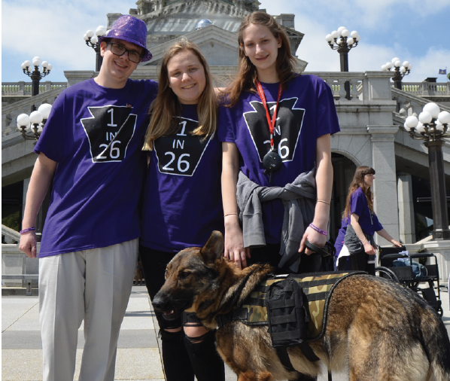
Our Mission
Epilepsy Alliance America is dedicated to supporting real-time support and services to those impacted by epilepsy in local communities by confronting the spectrum of challenges created by seizures.

Slide 4
Our Dedicated Board of Directors & Staff Members
Officers
Jeff Sinsebox - Chairperson
President & CEO, Empowering People’s Independence
Peggy Beem Jelley – Vice Chair
President & CEO, Epilepsy Association of Western and Central PA
Karen Basha Egozi - Treasurer
President & CEO, Epilepsy Alliance Florida
Kathy Schrag - Secretary
Executive Director, Epilepsy Alliance OH
Liza Gundell - Member-at-Large
CEO, Epilepsy Services of New Jersey
Board Members
Allison DeBattista – Board Member, Epilepsy Alliance Louisiana
Amanda Mitchell - Executive Director, Epilepsy Alliance Louisiana
Amy Challgren – Board Member, Epilepsy Alliance North Carolina
Dale Dean - CEO, DeanHouston, Inc. / Secretary, Epilepsy Alliance OH
Joyce A. Bender - CEO, Bender Consulting Services, Inc.
Michael A. Rosado - President, Puerto Rico Epilepsy Society
Patricia A. Gibson MSSW DHL ACSW - Executive Director, Epilepsy Alliance North Carolina / Assoc. Professor, Dept. of Neurology, Wake Forest University School of Medicine
Patricia Dean, ARNP, MSN - Clinical Coordinator, Comprehensive Epilepsy Center at Nicklaus Children’s Hospital in Miami, FLA.
Sarah Korba – Associate Director of Marketing, Empowering People’s Independence
Staff Member
Lisa Gallipoli – Chief Operating Officer

Slide 5
Our National Professional Advisory Committee
The National Professional Advisory Committee (NPAC) is comprised of epilepsy experts from a wide range of medical disciplines to advise our Board of Directors on program policy and development.
The NPAC recommendations are patient-centric. The NPAC provides advocacy support for mission-focused state and federal issues involving people with epilepsy, including access to care and regulatory concerns.
Alan Towne, MD, MPH
US Department of Veterans Affairs
Richmond, VA
Anto Bagić MD, PhD, FAES, FACNS
University of Pittsburgh
Pittsburgh, PA
Bruce Hermann, PhD
University of Wisconsin School of Medicine and Public Health
Madison, WI
Camilo Ivan Garcia, MD
Cleveland Clinic Florida, Weston Hospital, Weston, FL
Catherine Kamau, APRN -DNP
North Texas Institute of Neurology and Headache, TX
James Valeriano, MD
Allegheny Health Systems
PA
Kevin Rathke, MD
Duke University
Durham, NC
Marcelo Lancman, MD
Northeast Regional Epilepsy Group - NJ
Michael Smith, MD
Director - Rush Epilepsy Center
Chicago, IL
Patricia Dean, ARNP, MSN
Nicklaus Children’s Hospital
Miami, FL
R. Eugene Ramsay, MD
LA
Sarah Gehlert, PhD
University of Southern California
Los Angeles, CA
Sataya Gedela, MD, MRCP
Children’s Healthcare of Atlanta
Atlanta, GA
Steven White, RpH, PhD
University of Washington, School of Pharmacy
Seattle, WA
Vicky Whittemore, PhD
National Institute of Neurological Disorders and Stroke, National Institutes of Health
Bethesda, MD

Slide 6
Our Journey…To Date…
March 2022
EAA member organizations receive CDC SMART grant
August 2022
EAA member organizations conduct Back-to-School Seizure Preparedness Campaign
January 2021
EAA distributes >13,000 Seizure First Aid in the Age of COVID posters as children return to in-school learning across the USA
July 2018
8 Leading Epilepsy Organizations form Epilepsy Alliance America (EAA)
July 2019
EAA Website Launched
EAA publishes Services Brochure
March 2020
EAA creates National Professional Advisory Committee
July 2021
National sponsorship with SK life science begins
2018
2019
2020
2021
2022
August 2018
EAA Elects Board of Directors, Drafts ByLaws & Creates Committees
November 2019
EAA participates in Epilepsy Awareness Day at Disney
September 2020
EAA secures two new Member Organizations
August 2021
EAA hires first dedicated staff person (COO)
November 2021
EAA launches Seizure ID Program with funding from Jazz Pharmaceuticals
December 2021
EAA launches OnDemand Seizure Recognition and First Aid Training
September 2022
EAA secures four new Member Organizations – for a total of 17
November 2022
EAA exhibits at Epilepsy Awareness Day at Disney
December 2019
EAA attends / exhibits at AES Conference
December 2020
EAA exhibits at AES Virtual Conference

Slide 7
Our Current Member Organizations (17)
Founding Members
Members
Sophie’s Journey

Slide 8
Our Valued Partners & Sponsors
Partners
Jazz Pharmaceuticals plc (NASDAQ: JAZZ), is a fully integrated, global biopharmaceutical company with a diverse portfolio of marketed medicines and novel product candidates for adults and children, and expertise in two key therapeutic areas: neuroscience and oncology.
Sponsors
SK Biopharmaceuticals and its U.S. subsidiary SK life science are global pharmaceutical companies focused on the research, development and commercialization of treatments for disorders of the central nervous system (CNS). The companies have a pipeline of eight compounds in development for the treatment of CNS disorders, including epilepsy. Additionally, SK Biopharmaceuticals is focused on early research in oncology.

Slide 9
Our Programs and Services – Real-Time Epilepsy Help
HOBSCOTCH
One-on-one cognitive coaching
Managing Epilepsy Well
High-quality research across a network of universities, collaborating with community stakeholders to implement activities and disseminate research findings.
Telephone Support
We can talk through programs, services, and community resources that might be right for you.
Support Groups
For children, teens, adults, and parents impacted by epilepsy. These groups meet locally, as well as online.
Special Education Advocacy
Learn about the rights of children with epilepsy in school; Assistance with special education services (Seizure Action Plans, 504 Plans, and Individualized Education Plans)
Seizure Movement Monitor Assistance
We can connect you with resources that may be able to provide a monitor for free.
Seizure First Aid Training
We train school staff, including nurses, teachers, and support staff, and students of all ages how to recognize and respond to seizures. We also provide training for first responders and other community organizations.
Residential Services
We provide a safe home for some individuals who are severely impacted by epilepsy and other coexisting conditions.
Networking/Social Events
We host networking groups and social events for people of all ages, providing opportunities for those impacted by epilepsy to meet others who are confronting similar challenges.
Medication Assistance
We provide medication assistance for individuals and families who cannot afford their anti-seizure medications.
Legislative Advocacy
We can help you make sure your voice and your story are heard, by connecting you with your local legislators.
Information and Referrals
We provide information about epilepsy and connect people with other community resources and organizations which can provide additional support.
Individual/Family Consultation
Customized one-on-one support to individuals and families
Employment Assistance
Resume and interview skills assistance; identifying available jobs and providing training to employers.
Community Education
Conferences, workshops, webinars, and more to teach people about epilepsy and how to help their friends and neighbors that are affected by seizures.
Camp Programs
A wide selection of camp programs, including day programs, weekend camps, and weeklong summer camps. Including camps for children, teens, and adults with epilepsy.

Slide 10
Our Programs and Services – Real-Time Epilepsy Help
HOBSCOTCH
One-on-one cognitive coaching
Managing Epilepsy Well
High-quality research across a network of universities, collaborating with community stakeholders to implement activities and disseminate research findings.
Telephone Support
We can talk through programs, services, and community resources that might be right for you.
Support Groups
For children, teens, adults, and parents impacted by epilepsy. These groups meet locally, as well as online.
Special Education Advocacy
Learn about the rights of children with epilepsy in school; Assistance with special education services (Seizure Action Plans, 504 Plans, and Individualized Education Plans)
Seizure Movement Monitor Assistance
We can connect you with resources that may be able to provide a monitor for free.
Seizure First Aid Training
We train school staff, including nurses, teachers, and support staff, and students of all ages how to recognize and respond to seizures. We also provide training for first responders and other community organizations.
Residential Services
We provide a safe home for some individuals who are severely impacted by epilepsy and other coexisting conditions.
Networking/Social Events
We host networking groups and social events for people of all ages, providing opportunities for those impacted by epilepsy to meet others who are confronting similar challenges.
Medication Assistance
We provide medication assistance for individuals and families who cannot afford their anti-seizure medications.
Legislative Advocacy
We can help you make sure your voice and your story are heard, by connecting you with your local legislators.
Information and Referrals
We provide information about epilepsy and connect people with other community resources and organizations which can provide additional support.
Individual/Family Consultation
Customized one-on-one support to individuals and families
Employment Assistance
Resume and interview skills assistance; identifying available jobs and providing training to employers.
Community Education
Conferences, workshops, webinars, and more to teach people about epilepsy and how to help their friends and neighbors that are affected by seizures.
Camp Programs
A wide selection of camp programs, including day programs, weekend camps, and weeklong summer camps. Including camps for children, teens, and adults with epilepsy.

Slide 11
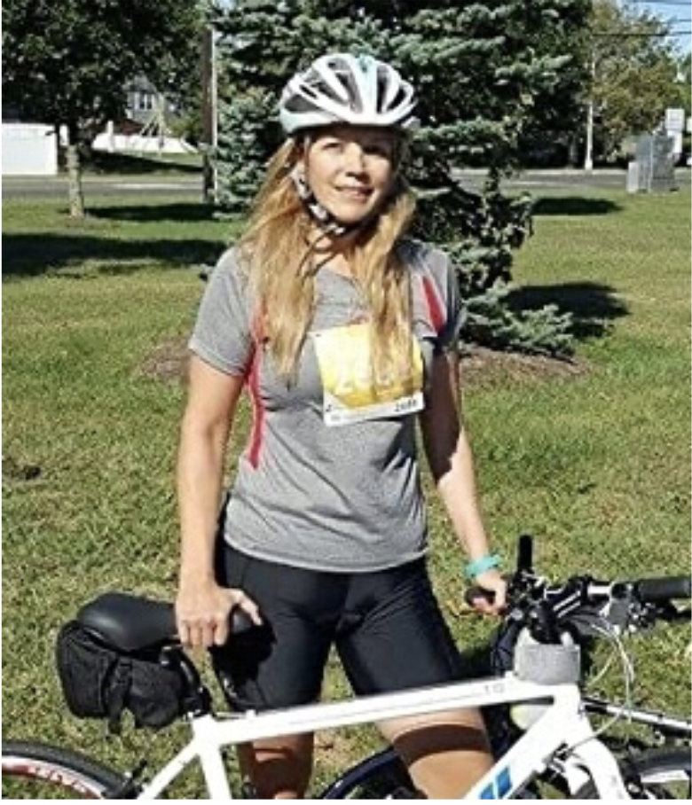
Our Signature National Programs
On-Demand Seizure First Aid Training for School Personnel
This Seizure Recognition and First Aid Training was developed for school personnel. All school personnel - teachers, administrators, nurses, drivers, coaches, aides, custodians - can benefit from this training. While the training addresses specifics about the school-setting, anyone seeking to learn the basics of epilepsy and how to recognize and respond to a seizure could benefit from the content.
Lorna Myers PNES Scholarship Program
Dr. Lorna Myers annually donates the royalties of her book, Psychogenic Non-Epileptic Seizures: A Guide to Epilepsy Alliance America.
Using these funds, Epilepsy Alliance America established a scholarship program for students with a diagnosis of psychogenic non-epileptic seizures (PNES) who are pursuing
higher level education
at a university or college
or a trade, technical or
professional school.
On-Demand Training is available 24/7.
Continuing education credits (1.0) are available for certified health educators (CHES)
Dr. Lorna Meyers

Slide 12
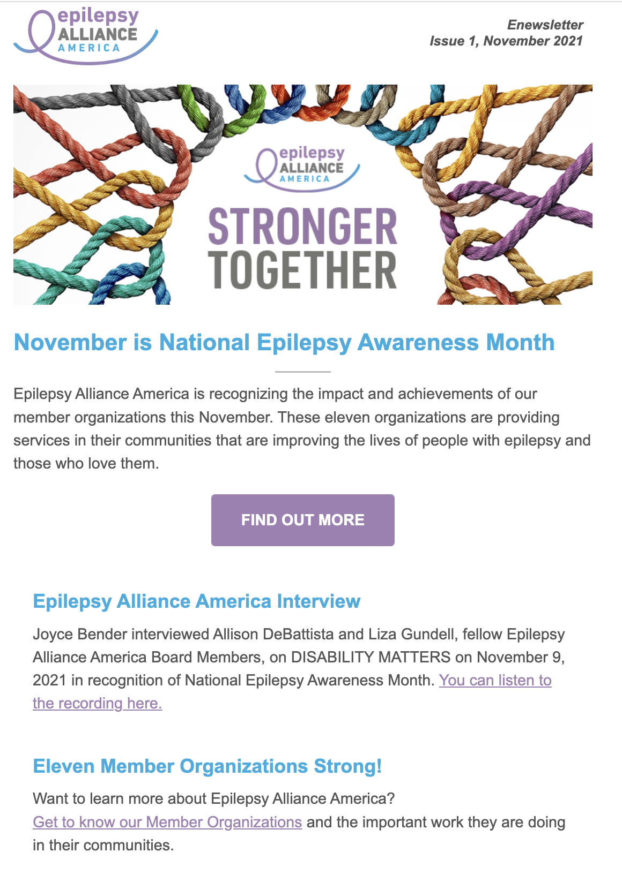
Sponsorship Opportunities
SPECIAL RECOGNITION DAYS
National Epilepsy Awareness Month (November)
1 in 26 Day (January 26)
Epilepsy Alliance America will create a special landing page featuring the activities of the Member Organizations.
Opportunity to have company logo on the page, mention in eNewsletter and social media posts.

Slide 13
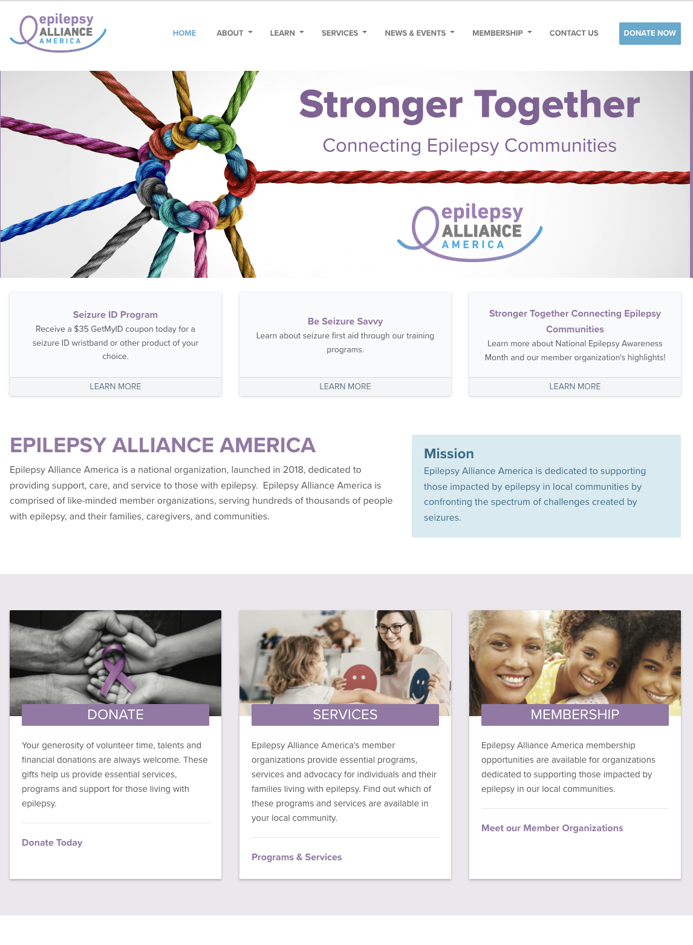
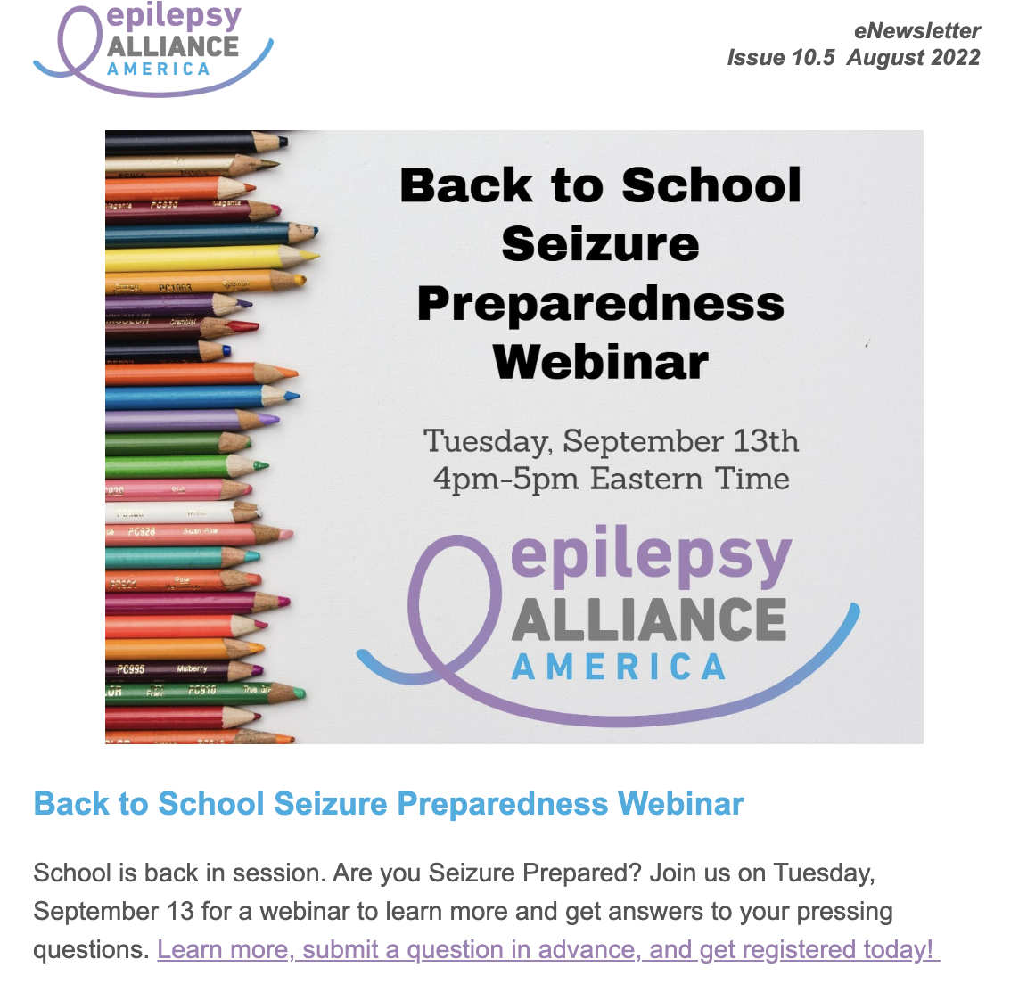
Sponsorship Opportunities
Epilepsy Alliance America Website & eNewletter
www.epilepsyallianceamerica.org has over 3,000 unique visitors each month and we anticipate this to double by the end of 2022.
Epilepsy Alliance America’s monthly newsletter has a distribution of 1,000.

Slide 14
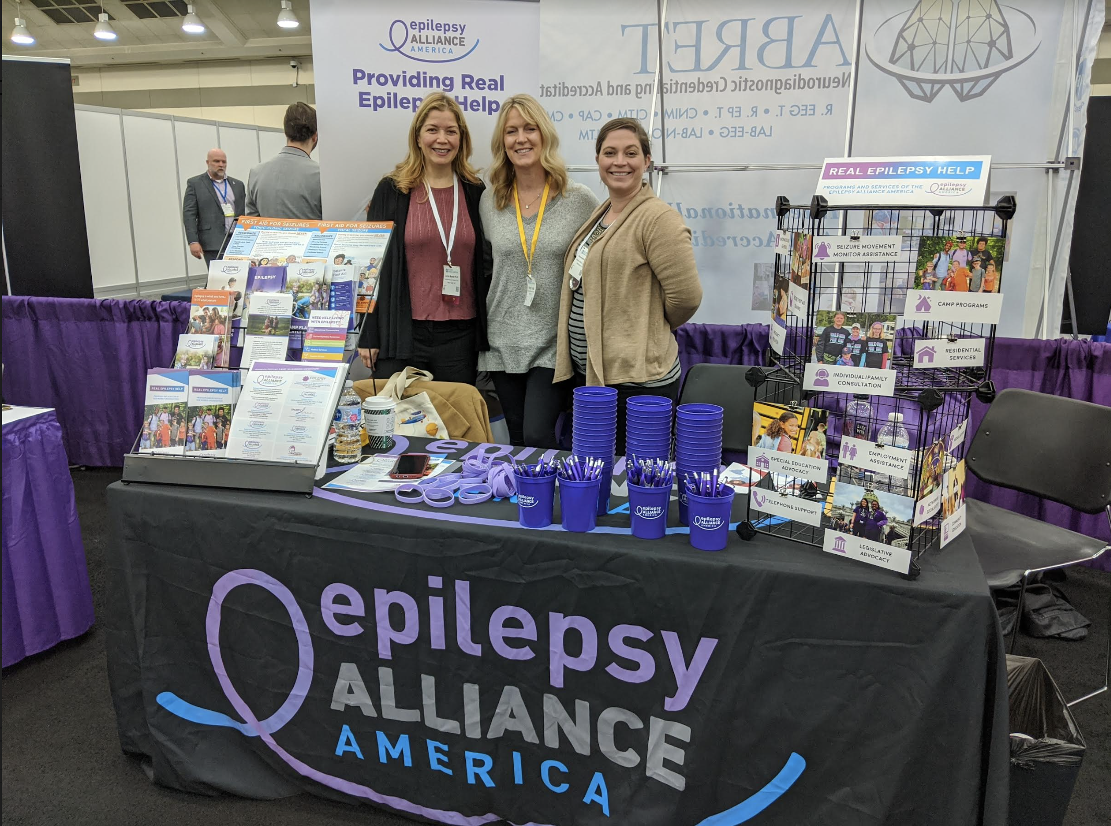
Sponsorship Opportunities
EPILEPSY ALLIANCE AMERICA at American Epilepsy Society (AES) Annual Meeting – December
Sponsor to support the National Professional Advisory Committee breakfast meeting
Sponsor to support a cocktail reception for NPAC members, Board members, community partners at American Epilepsy Society meeting

Slide 15
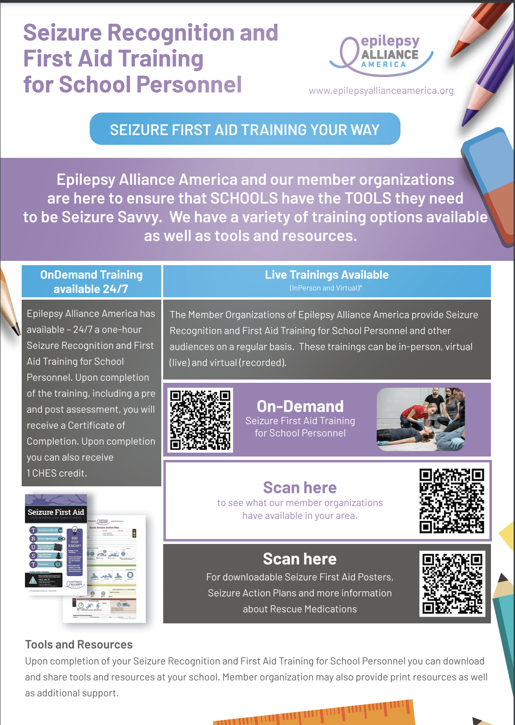
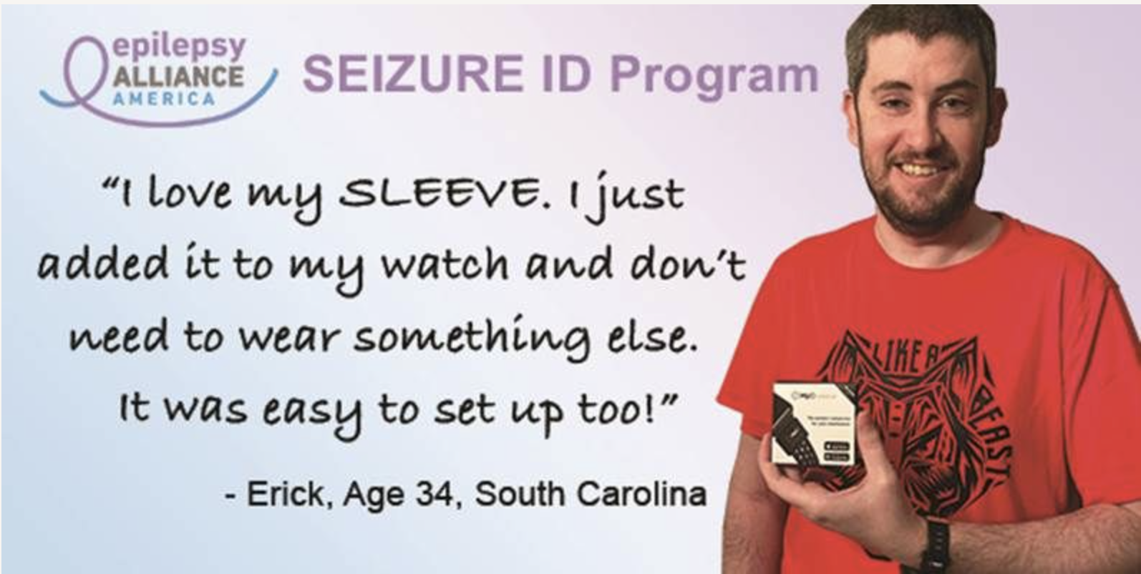
Sponsorship Opportunities
Custom Opportunities available to partner with sponsors interested in Program Development and Content
Examples:
SK life science S.T.E.P.S Program
Back to School Seizure Preparedness Awareness Campaign
Seizure ID Program

Slide 16
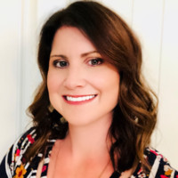
Membership Benefits and Opportunities
“As a member of Epilepsy Alliance America, Valley Children’s Healthcare has been able to expand resources for our Epilepsy Support Program, improving outreach to Central California families and increasing the educational resources we offer them.
The ability to network, support and collaborate with other members throughout the country has proven to be remarkably valuable.
We partnered with Epilepsy Alliance America to create and distribute a series of seizure medication education videos, hoping that our own knowledge and expertise could assist others in the organization. We look forward to our continued relationship in the years to come, with the goal of helping families in need, wherever and whenever we can.”
Caitlin Bernard-Vincent, MSW, LCSW Epilepsy Program Manager
Caitlin Bernard-Vincent, MSW, LCSW Epilepsy Program Manager

Slide 17
Membership Benefits and Opportunities
Epilepsy Alliance America builds strong, inspired, engaged, and resourceful community relationships among epilepsy organizations. We are commitment to helping organizations connect local epilepsy leaders to knowledge, resources, and peer supports that advance the mission of improving the quality of life for individuals living with epilepsy.
Two types of membership are currently offered:
Non-Profit Member Organization
Be listed on the EAA website with a link to your local organization
Network with other leaders in the epilepsy community
Participate in forums to share ideas, policies, and best practices
Participate in modeling national programs
Participate in member-only educational opportunities
Work along side other advocates to advance epilepsy-related public policy
Be listed as a member organization of EAA in media publications and websites
Be eligible to access Epilepsy Alliance America educational resources
Proudly display the Epilepsy Alliance America membership logo that signifies you are a part of a national network dedicated to quality epilepsy programs
Serve on an EAA Committee and/or Board of Directors
Select Partner Member Organization Select Partner Member Organizations will receive all the Non-Profit Member Organization benefits – PLUS – they are eligible to participate in the governance of Epilepsy Alliance America by:
Nominating individuals to the National Board of Directors for voting privileges
Nominating individuals to the EAA National Professional Advisory Committee
Sharing of Sponsorship / financial resources when available

Slide 18
Membership Benefits and Opportunities
Epilepsy Alliance America builds strong, inspired, engaged, and resourceful community relationships among epilepsy organizations. We are commitment to helping organizations connect local epilepsy leaders to knowledge, resources, and peer supports that advance the mission of improving the quality of life for individuals living with epilepsy.
Two types of membership are currently offered:
Non-Profit Member Organization
Be listed on the EAA website with a link to your local organization
Network with other leaders in the epilepsy community
Participate in forums to share ideas, policies, and best practices
Participate in modeling national programs
Participate in member-only educational opportunities
Work along side other advocates to advance epilepsy-related public policy
Be listed as a member organization of EAA in media publications and websites
Be eligible to access Epilepsy Alliance America educational resources
Proudly display the Epilepsy Alliance America membership logo that signifies you are a part of a national network dedicated to quality epilepsy programs
Serve on an EAA Committee and/or Board of Directors
Select Partner Member Organization Select Partner Member Organizations will receive all the Non-Profit Member Organization benefits – PLUS – they are eligible to participate in the governance of Epilepsy Alliance America by:
Nominating individuals to the National Board of Directors for voting privileges
Nominating individuals to the EAA National Professional Advisory Committee
Sharing of Sponsorship / financial resources when available

Slide 19
Learn More About Epilepsy Alliance America - Contact Us Today
Staff Contact: Lisa Gallipoli Chief Operating Officer Phone: (347) 987-1610
Email: Lisa.Gallipoli@EpilepsyAllianceAmerica.org
Our Business Address: 11822 Justice Avenue; Suite B4 Baton Rouge, LA 70816
About Epilepsy Alliance America Epilepsy Alliance America is a non-profit organization Our Tax ID number (EIN) is: 83-1218385

Slide 20
CONNECTING EPILEPSY
COMMUNITIES

